Slide 1
a) Embedded systems are application specific & single functioned; application is known apriori, the programs are executed repeatedly.
b) Efficiency is of basic importance for embedded systems. They are optimized for energy, code size, execution time, weight & dimensions, and cost.
c) Embedded systems are typically designed to meet real time constraints; a real time system reacts to stimuli from the controlled object/ operator within the time interval dictated by the environment. For real time systems, right answers arriving too late (or even too early) are wrong.
d) Embedded systems often interact (sense, manipulate & communicate) with external world through sensors and actuators and hence are typically reactive systems; a reactive system is in continual interaction with the environment and executes at a pace determined by that environment.
e) They generally have minimal or no user interface.

Slide 2
Definition
Embedded Systems is a special purpose computer system/board, which covers all the devices such as processor, memory, interface and control in single package or board to perform only a specific application tasks.

Slide 3
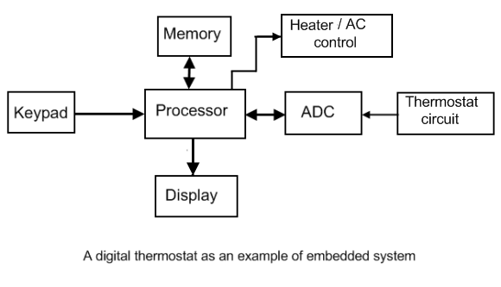
Typical Example of an Embedded System

Slide 4
Hardware components of an Embedded System
• CPU: Microprocessor/ Microcontroller/DSP
• Non Volatile memory: EPROM, Flash
• Volatile memory: DRAM, SRAM
• System clocks: RTC circuitry, System clock
• Standard devices: I/O ports, peripherals,
• Custom devices: FPGA, PAL
• Communication devices and drivers: Ethernet, RS-232, USART
• Debug mechanism: Debug port, Watchdog timer, JTAG, ICE
• Buses for device networks: I2C, CAN, SPI, etc.

Slide 5
Essential Considerations
• Response Time -- Real Time Systems
• Area
• Cost
• Portability
• Low Power (Battery Life)
Fault Tolerance-continue operation despite
hardware and software faults

Slide 6
Processor Classifications
Based on register size
-8 bit
-32 bit
Processors can be classified as 8 bit/16 bit/32 bit /64 bit based on the size of their internal registers.
• Typically, the data bus width equals the size of the data registers so that the register data can be read/written in one read/write cycle.

Slide 7
Based on Endianness
Big Endian
Little Endian
Big Endian
Eg: SPARC, power PC
Little Endian
Intel processors
• Configurable Processors
some processors can be configured during bootup process as big or little endian. Eg: ARM processors

Slide 8
Based of instruction set
RISC
CISC
RISC
• Only load/store instructions use the external memory.
• All instructions are same size and fixed length.
• Number of instructions available are less compared to CISC.
• Typically has less pipeline stages than CISC.
Eg ARM processor.

Slide 9
CISC
Most instructions can operate directly
on external memory.
• Hence require less number of registers.
• Instructions are of different sizes. Hence they take varied clock cycle to decode and execute each instruction
• Pipeline stages take varied times and hence pipeline is not so efficient as the RISC processors.

Slide 10
More number of instructions since many
complex operations are implemented
Eg: Intel Pentium processors

Slide 11
Based on Bus Architecture
Von Neumann Architecture
Harvard Architecture

Slide 12
Von Neumann
A Von-Neumann Machine Architecture provides one data path (bus) for both instruction and data
• As a result, the CPU can either be fetching an instruction from memory, or read/writing data to it
• Other than less complexity of hardware, it allows for using a single, sequential memory.
• Today’s processing speeds vastly outpace memory access times, and we employ a very fast but small amount of memory (cache)
local to the processor

Slide 13
Harvard
Harvard Architecture refers to a memory structure where the processor is connected to two different memory banks via two sets of buses
• This is to provide the processor with two distinct data paths, one for instruction and one for data
• Through this scheme, the CPU can read both an instruction and data from the respective memory banks at the same time
• This inherent independence increases the throughput of the machine by enabling it to always prefetch the next instruction
• The cost of such a system is complexity in hardware
Commonly used in DSPs

Slide 14
Modern processors employ a Harvard Architecture to read from two instruction and
data caches, when at the same time using a
Von-Neumann Architecture to access external
memory

Slide 15
Based on Functionality
General purpose Processors
Special purpose Processors- DSP, Network
General purpose processors:
All the regular processors
Special purpose processors:
Digital Signal Processors
DSP processors are microprocessors designed for efficient mathematical manipulation of digital signals.
They are optimized for doing intense addition and
multiplication operations.

Slide 16
Network Processors
Used in routers. Multiple processors are pipelined to process the network packets in a optimal way.
Each processor processes multiple packets
concurrently in multiple threads.
Eg : IXP1200 from Intel

